Slide 1
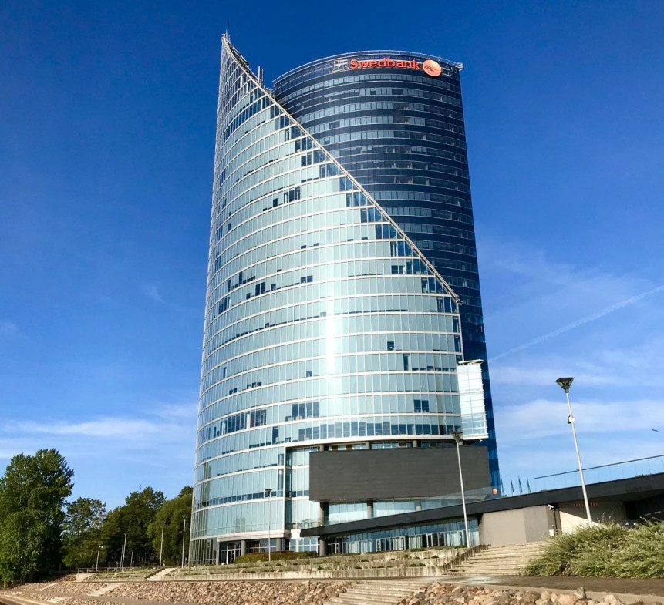
EPCA Forum
Riga, October 2023

Slide 2
EPCA Forum program overview
Pre-day dinner | 26 October 2023
 | Dinner
Time | 19:30
Location | Restaurant Italissimo, Baznicas 27/29, Riga, Latvia
Menu | Prepared menu with alternatives (vegetarian options avaiable)
Reservation | For 12 people
EPCA Forum Day | 27. October 2023
 | EPCA Forum
Time | 8:30 – 17:00
Location | Swedbank Headquarters , Balasta dambis 15 , Riga, Latvia
Room | For 12 people
Lunch | At the EPCA Forum venue

Slide 3
EPCA Forum 2023
Payments in Europe is undergoing a cool-off period. Well established fintechs – Klarna, Revolut or N26 - have slashed their evaluations to below 50% during the last 12 – 15 months. Start-up and scale-up fintechs see a strong need for profitability in their business outook otherwise funding is simply not available. Many of such entities who failed to turn the strategy from market share and coverage to profitability had to call it quits. Traditional payment providers – Worldline, Nexi, Adyen, saw their stock price take a significant dive recently.
So for some markets and market participants to make it work in European payments can be a bit mysterious, at least shadowy or even outright scary. And as it’s the end of October we felt, a Halloween theme might just be suitable for the EPCA Forum 2023.

Slide 4
EPCA Forum agenda (1/3)
EPCA Forum theme | tbc
 | Coming to the venue, getting a post-breakfast coffee | 8:30 – 8:40
Mikko Rieger EPCA chairman | Brief welcome and opening of the day | 8:40 – 8:50
Topic 1 | Schemes in haunted house – connecting to the cloud | 8:50 – 9:30
Ludmila Berzina Vedicard | A summary of the Payment Conference and providing a technical overview on scheme connectivity to the cloud
 | based on recent project engagements of Vedicard
Topic 2 | iDEAL and the EPI ghost | 9:30 – 10:15
Eppo Heemstra Connective Payments | A tour through the set-up and developments from the initiation of iDEAL towards the future of EPI after the take-over of iDEAL.
 | Eppo presenting findings based on several projects done by Connective Payments for iDEAL and recent publications on the EPI road-map.
 | Coffee break | 10:15 – 10:30
Topic 3 | Frightening or not? - Hot topics inside traditional banking | 10:30 – 11:30
Ģirts Bērziņš Swedbank Group | Swedbank Group’s overview on their digital journey and pain points in the last 10 years and current hot topics in the digital banking context
 | Presentation and Q&A

Slide 5
EPCA Forum agenda (2/3)
Topic 4 | The gruelsome Payment Service Regulations
Emmanuel Caron Galitt | How do we see Payment Services Regulation further develop and what does PSD 3 bring upon us. | 11:30 – 12:15
 | Emmanuel put together some insights into PSR development from recent project work
Topic 5 | Nightmare on Acquiring Street | 12:15 – 13:00
Peter Jones PSE Consulting | Traditional acquirers face fierce competition from payment gateway providers.
 | Peter sheds some light on how competition has geared up, how traditional acquirers try to defend their turf and who else wants a piece of the pie.
 | Lunch | 13:00 – 13:50
EPCA internal:
Topic 6 | EPCA Administration
Peter Jones & Hugo Godschalk | Last 12 – 15 months, budget 2023, chairman role and election, next steps of development, such as new members, website updates, accounting cost reductions; joint projects | 13:50 – 14:50
 | Coffee Break | 14:50 – 15:00

Slide 6
EPCA Forum agenda (3/3)
New market members:
Topic 7 | “TRUCO O TRATO” = major fears in Spanish payments | 15:00 – 15:45
Luis De Miguel and Jaime Pérez, Nalba | A brief introduction to the Spanish market context, followed by main concerns/fears that the different Spanish financial entities are facing, and how they are responding to them.
 | Luis will focus on a few selected payment developments based on their own project work and market observations
Topic 8 | Pumpkin, Spice and Latte in your Banking App (through digital receipts)
Mikko Rieger rieger.fi | Digital receipts show early market adoption across Europe. Various parties have different interests in those. Solutions are mainly driven by the main stakeholder and interest | 15:45 – 16:30
 | Mikko to present findings from recent strategy work and ongoing business development in the DACH and Nordics regions.
 | Summary and closing of this year’s EPCA Forum | 16:30 – 16:45

